Slide 1
Ceremonial Stone Landscapes Day
October 7, 2017
Hopkinton, RI
Presentation by
Mary Gage & James Gage
© 2017

Slide 2
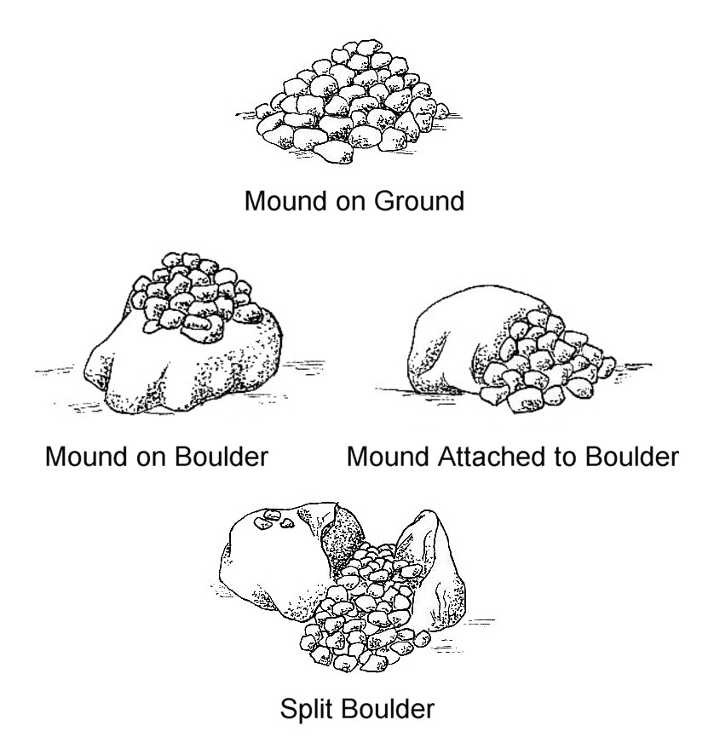
A small sample of the diversity of stone cairn designs

Slide 3
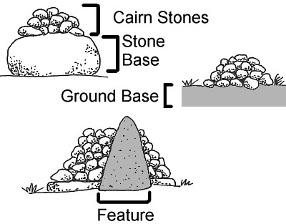
The Basic Components of a Stone Cairn

Slide 4
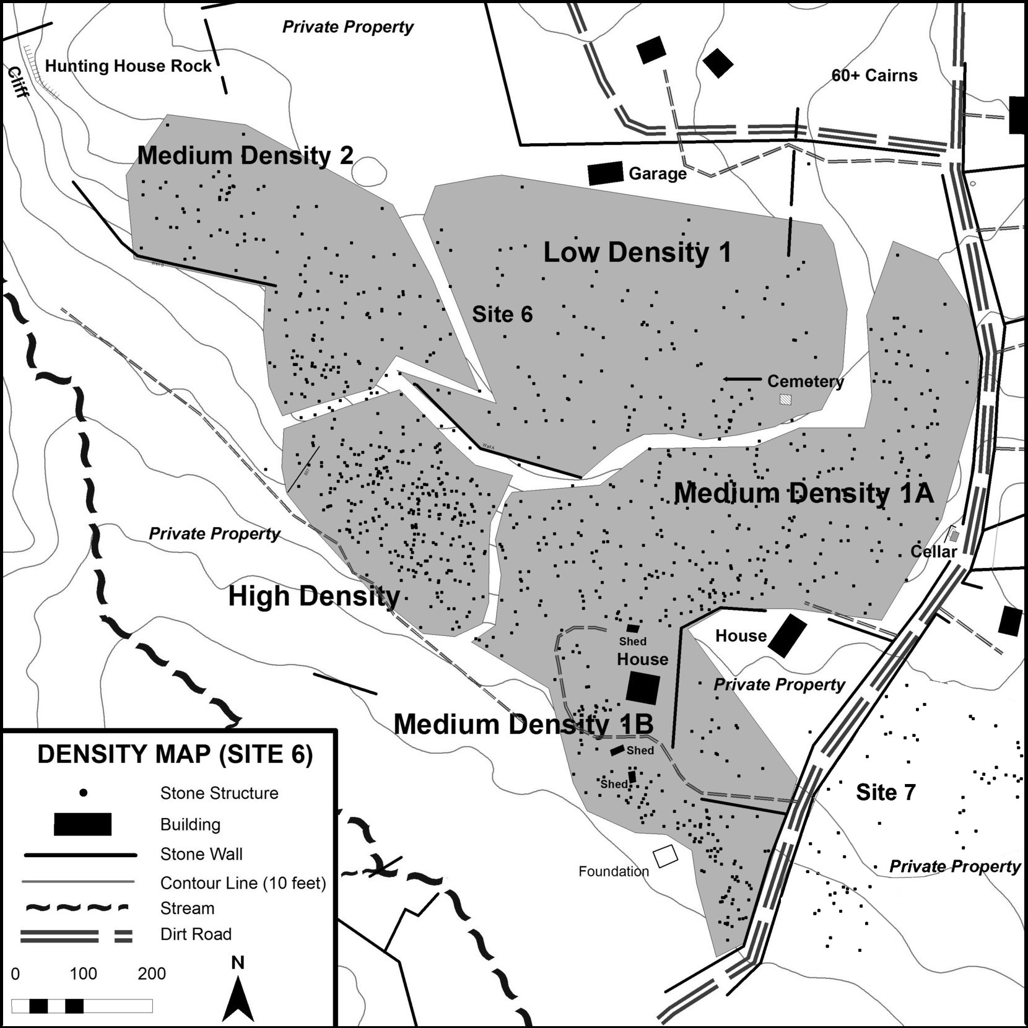

Slide 5
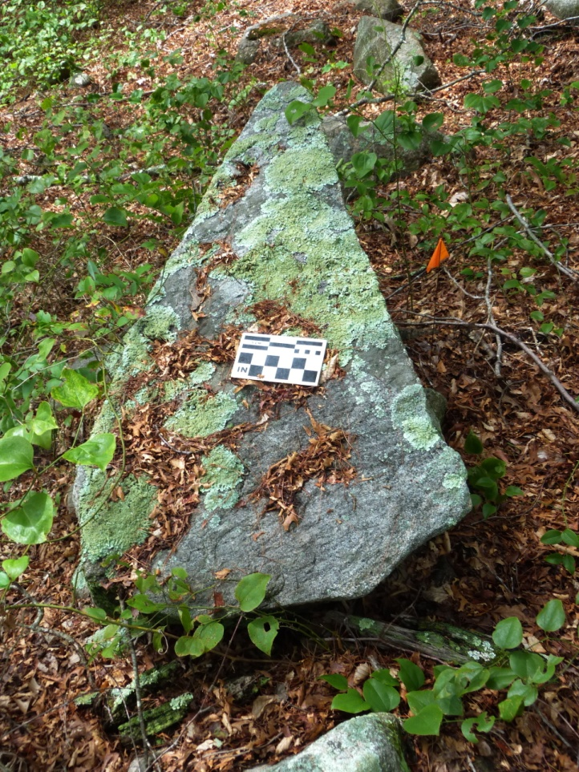
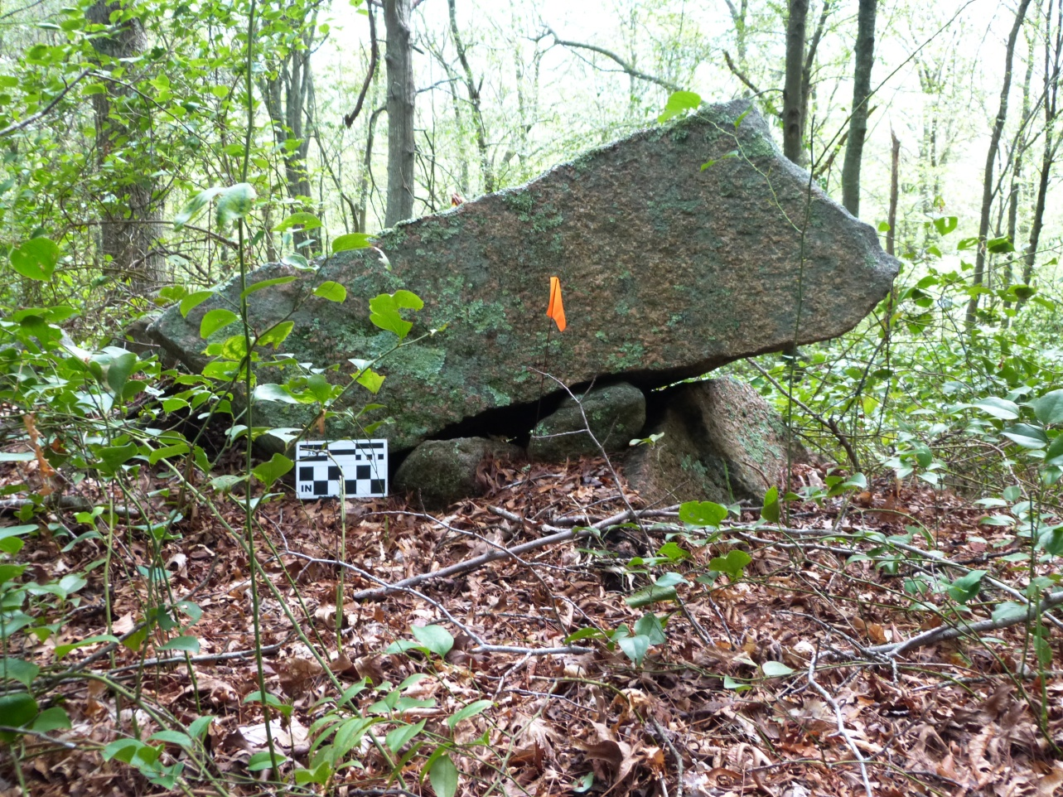
Head of Serpent Wall

Slide 6
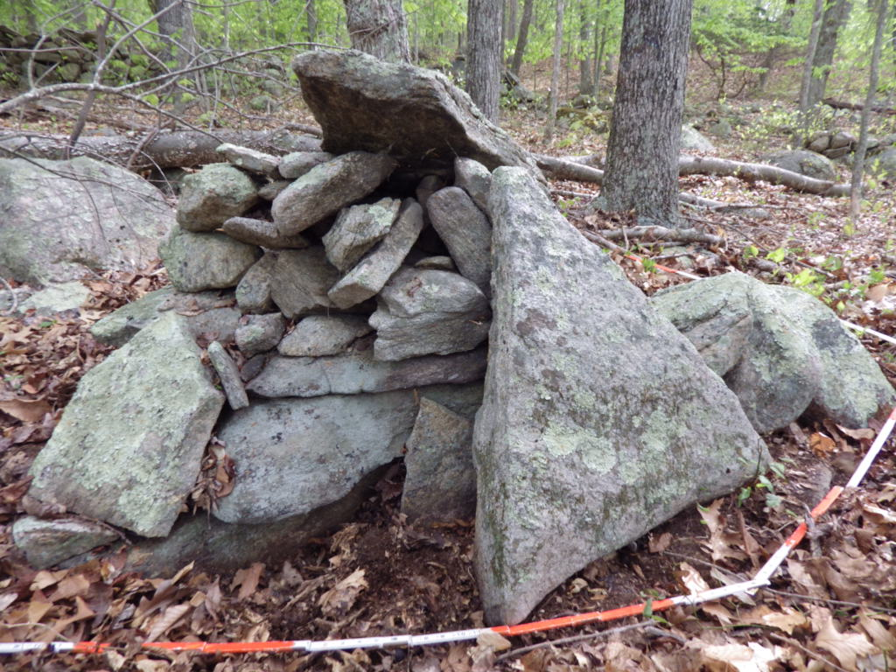
1
2
3
Triangular symbolism

Slide 7
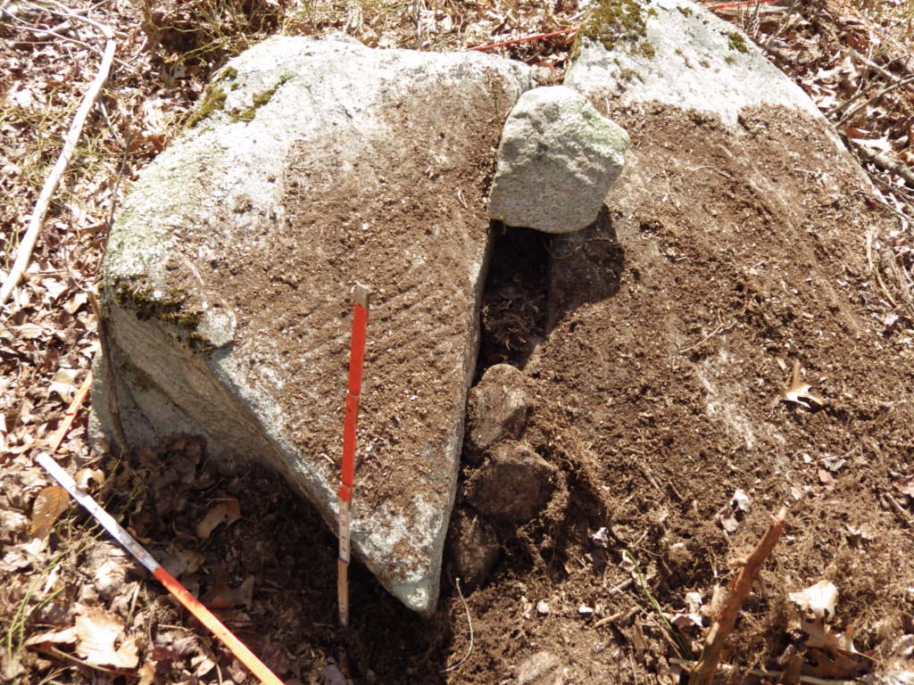
Split

Slide 8
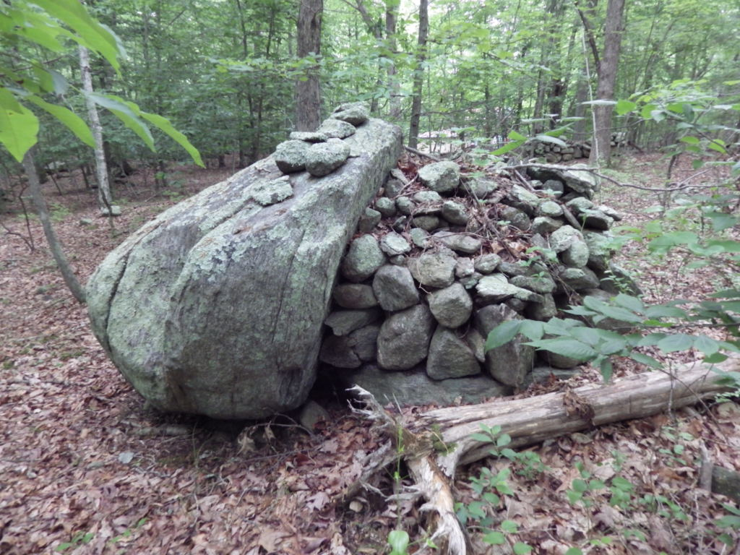
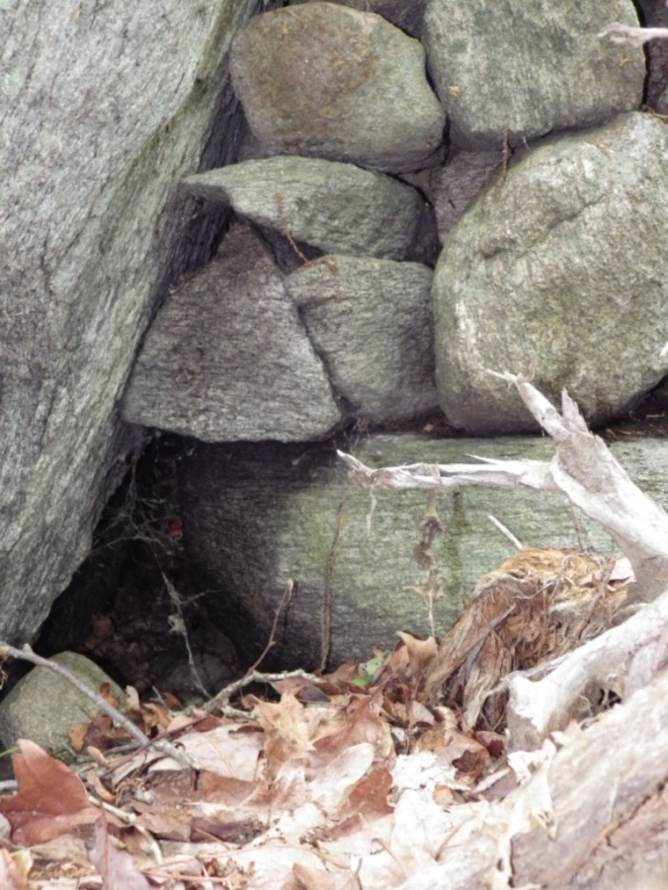
Triangle over tunnel feature

Slide 9
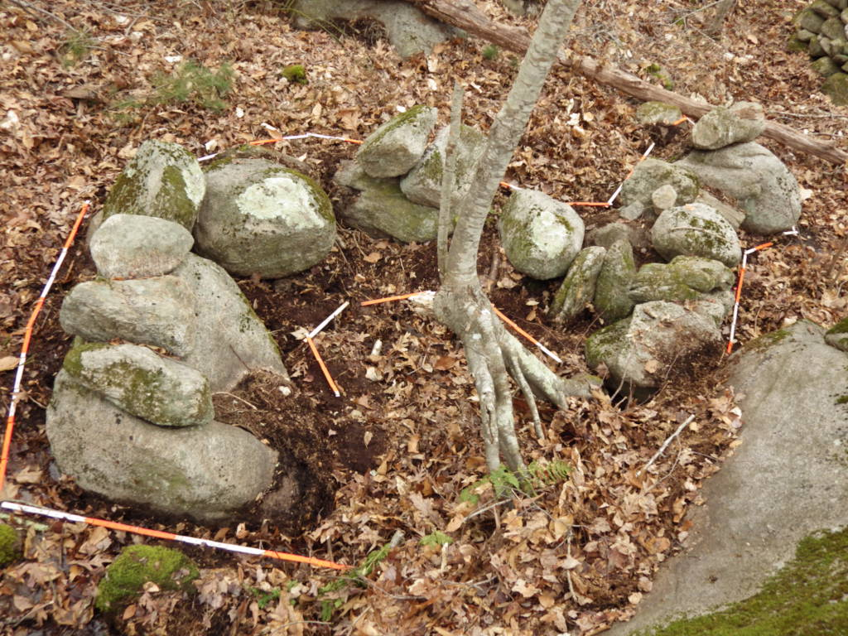
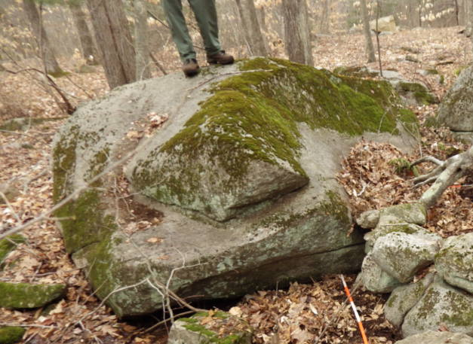
Serpentine shaped enclosure Serpent Head

Slide 10
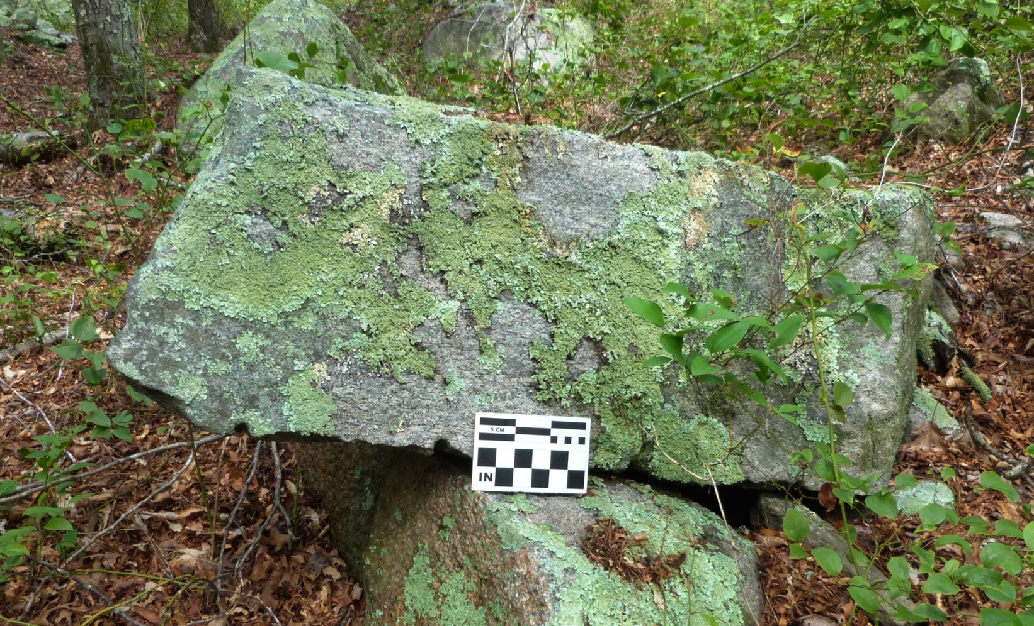
Drill Holes

Slide 11
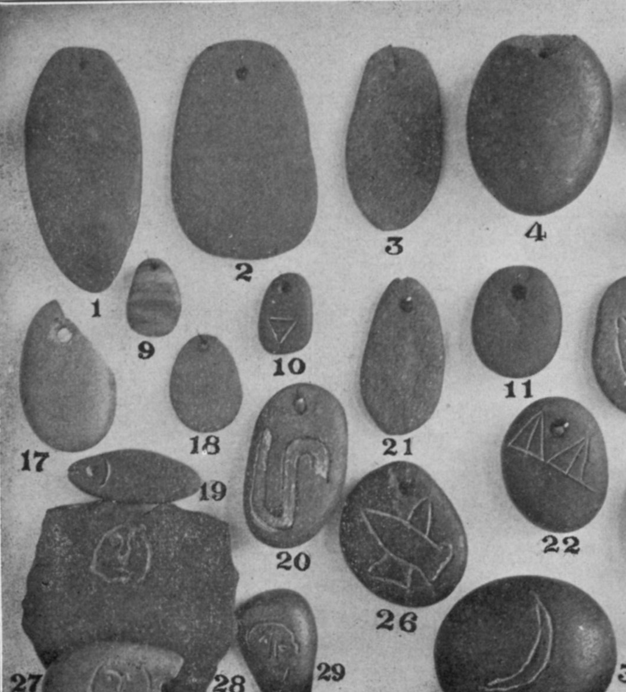
Serpent Effigy Pendant

Slide 12
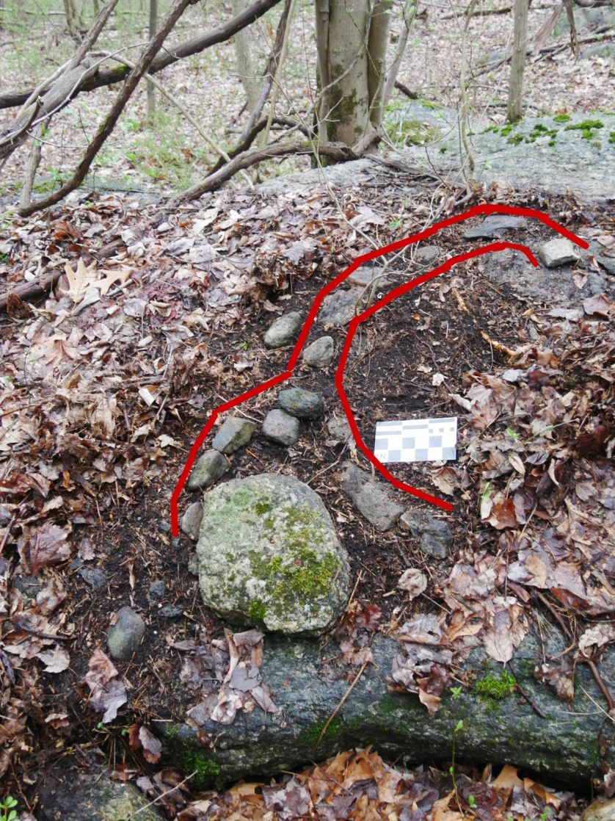
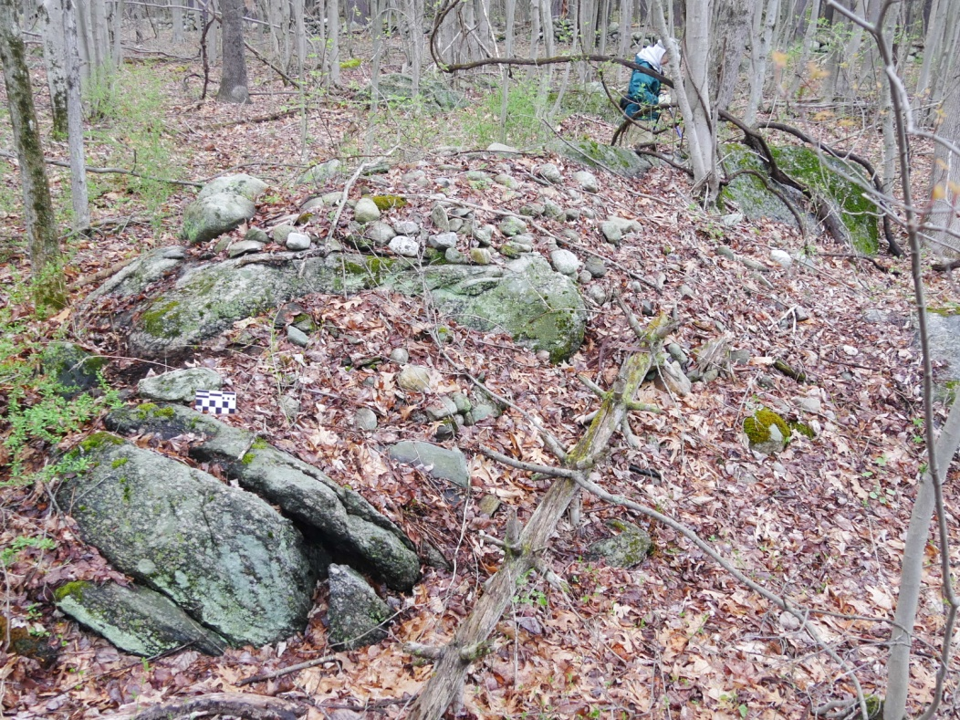
Serpent Ceremonies
Kent, CT
Serpent Effigy

Slide 13
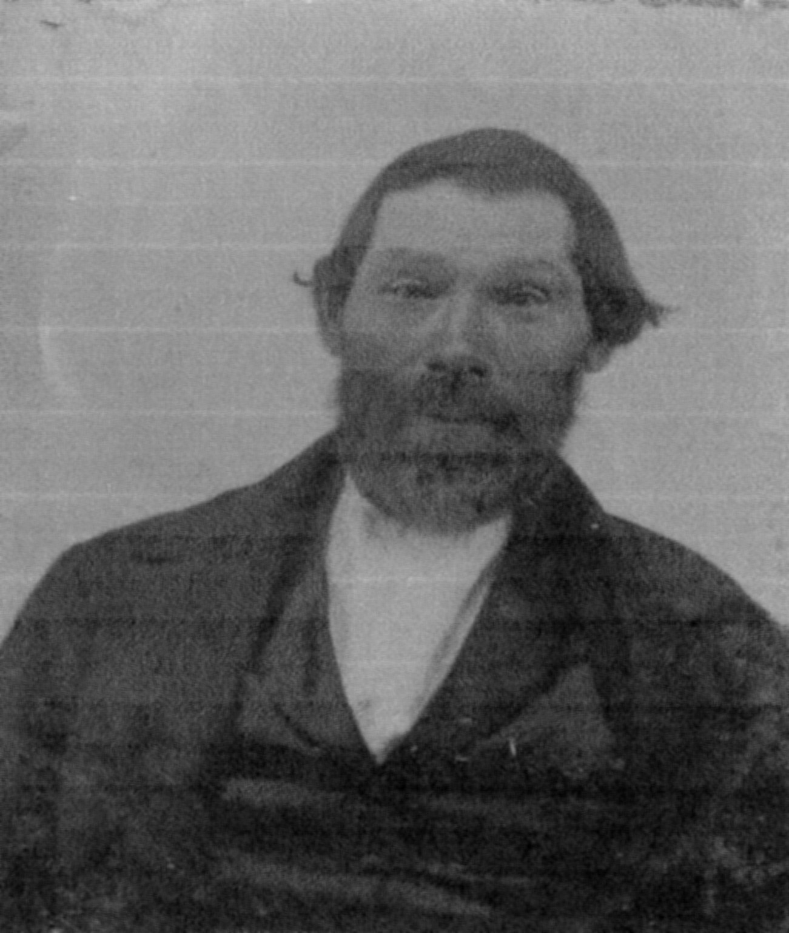
Lawton Foster
Courtesy of the Hopkinton Historical Society

